Slide 1
Word Character and Number Counter
Guided By:
Jayanth V Sir
Presented By:
Pranita Lahu Chopade

Slide 2
Content
Introduction of topic
Languages used
Screenshots

Slide 3
Introduction
I have developed live words , character and number counter.
Why I choose this topic?

Slide 4
Languages Used
HTML
HTML stands for Hyper Text Markup Language
HTML describe the structure of a web page.
HTML element tell the browser how to display the content.

Slide 5
Languages Used
CSS
CSS stands for Cascading Style Sheet.
CSS describe how to HTML element are to be displayed.
CSS saves lot of work . It can control the layout of multiple web pages all at once.

Slide 6
Languages Used
JAVASCRIPT
JavaScript is commonly used for creating web pages.
It allows us to add dynamic behavior to the webpage and add special effects to the webpage.
On websites, it is mainly used for validation purposes.
JavaScript helps us to execute complex actions and also enables the interaction of websites with visitors.

Slide 7
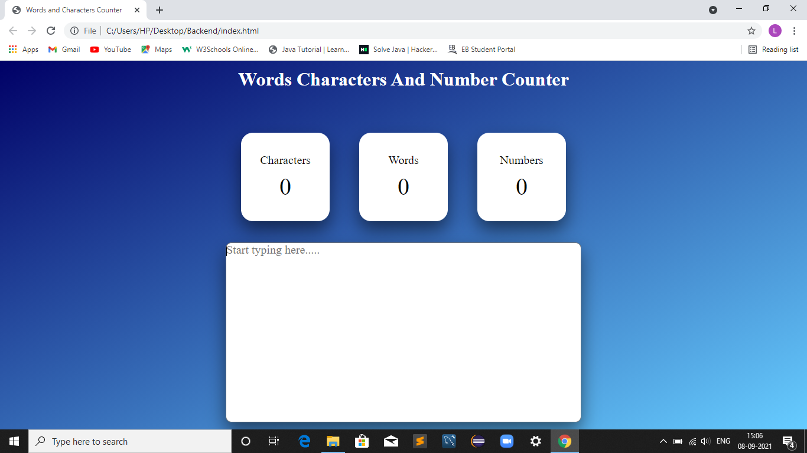
Screenshot

Slide 8

Screenshot

Slide 9
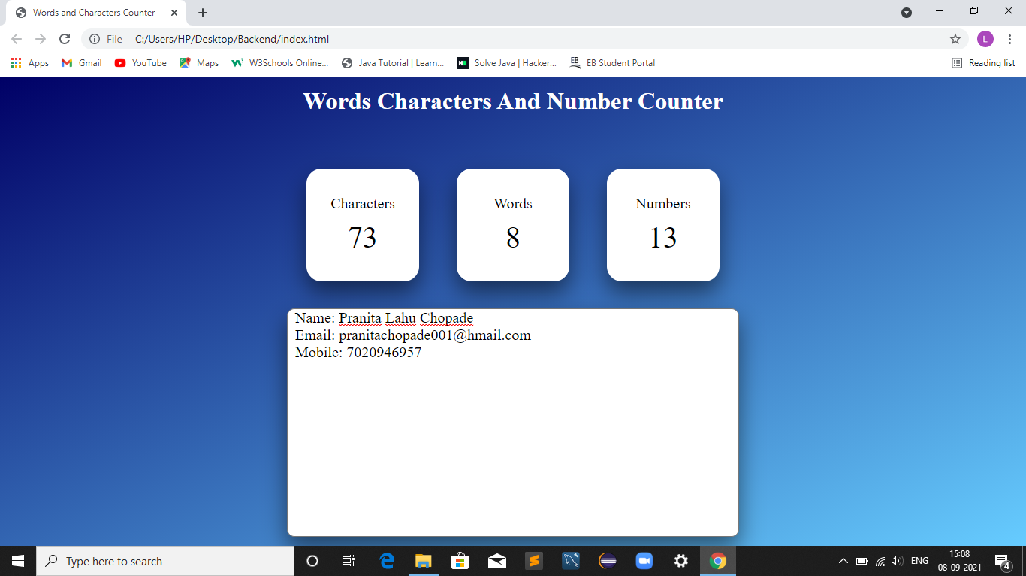
Screenshot

Slide 10
Conclusion
The purpose of this website is to make user friendly website.
Help the writer better understand the length of their writing.

Slide 11
THANK YOU

